Slide 1
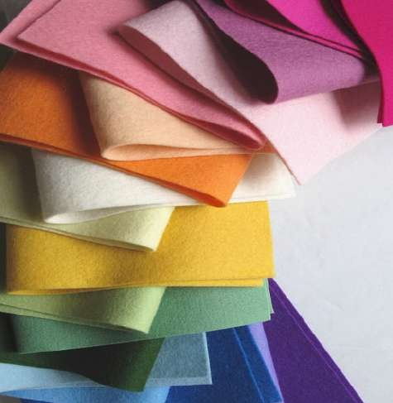



















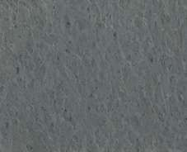


FIELTRO
WIDTH (CM) | COMPOSITION | WEIGTH (GSM) | ROLLS (M)
90 | POLYESTER 100% | 180 GSM | 28 M
THICKNESS: 1,1 MM LAUNDRY CARE:
COLORES:
0000
4003
5000
3005
0004
2008
5002
6004
0003
4005
5001
6006
3001
4001
5003
6002
3004
4000
5004
6001
2001
4004
5005
1001
2003
4002
1000

